Slide 1
pedestrian safety
Crosswalk detection, Traffic light recognition

Slide 2
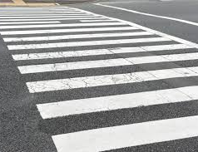
Crosswalk Detection
Identifying road markings
Handling various crosswalk designs

Slide 3
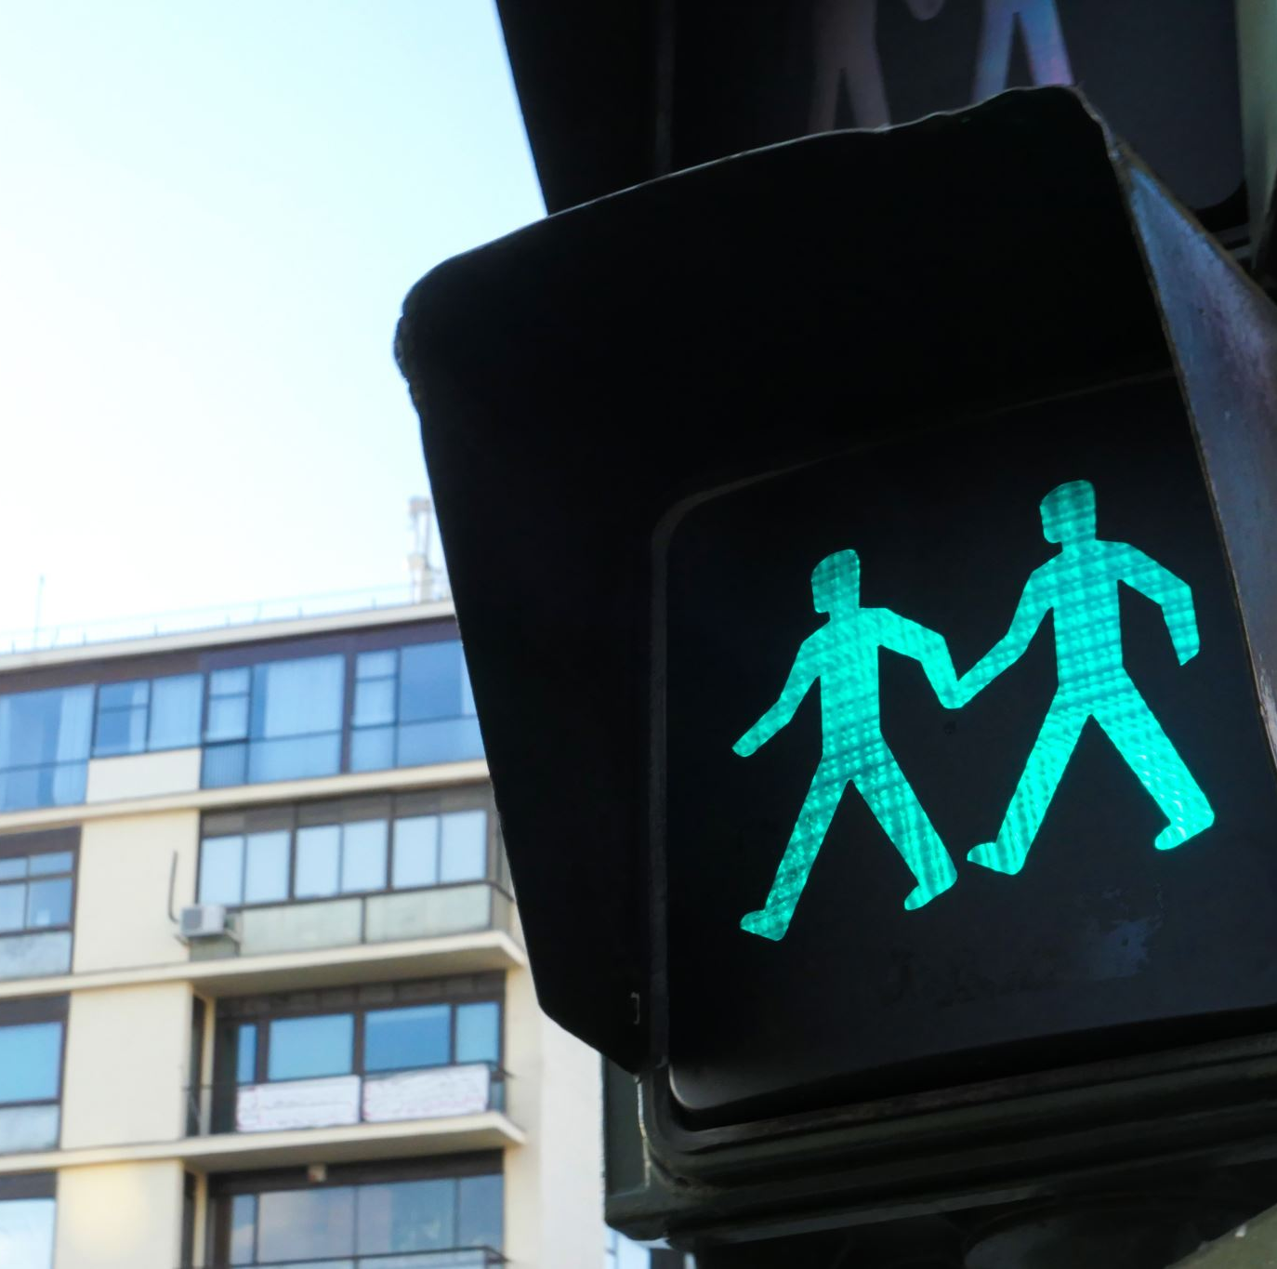
Crosswalk Light Detection
Recognizing traffic signal structures
Interpreting light colors and pattern

Slide 4

Benefits and Applications
Enhanced pedestrian safety
Assistance for visually impaired individuals
Integration with autonomous driving systems
Smart city traffic management

Slide 5

Data collection

Slide 6
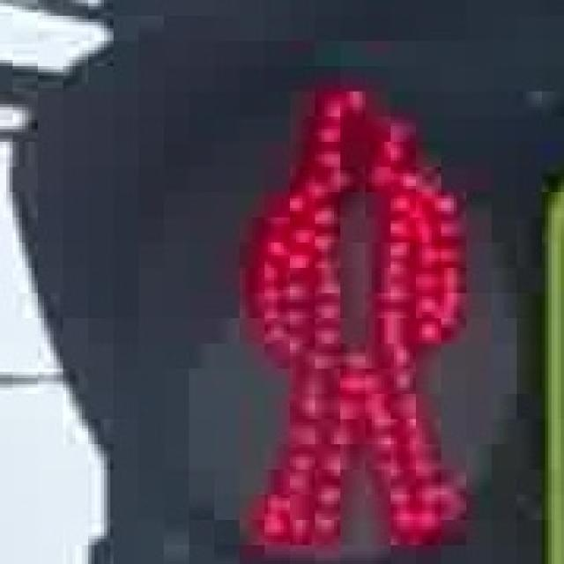
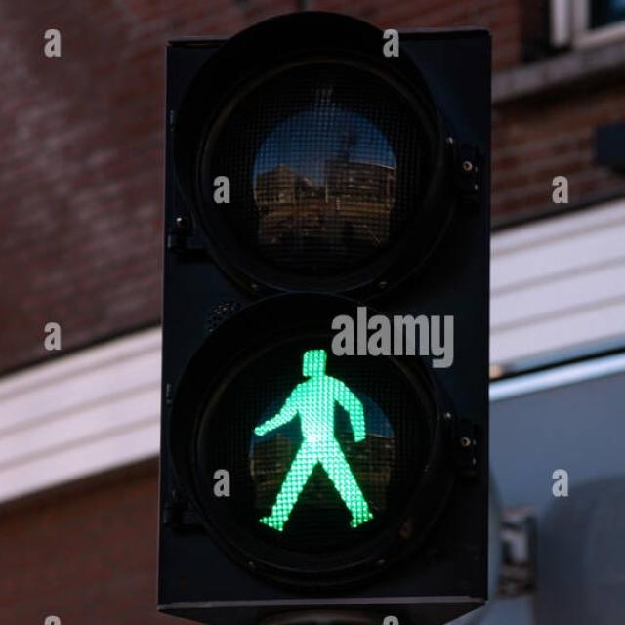
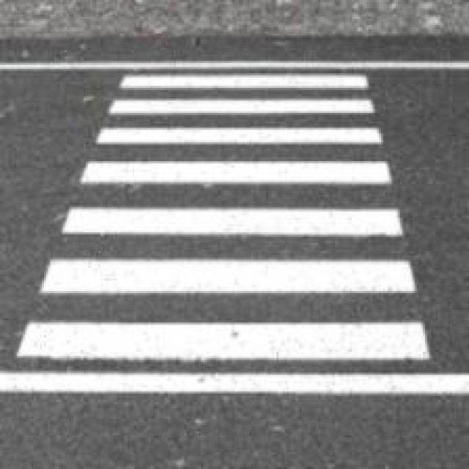
Dataset examples

Slide 7


Database
Why MongoDB
Free Version Availability
Ease of Use
Scalability

Slide 8
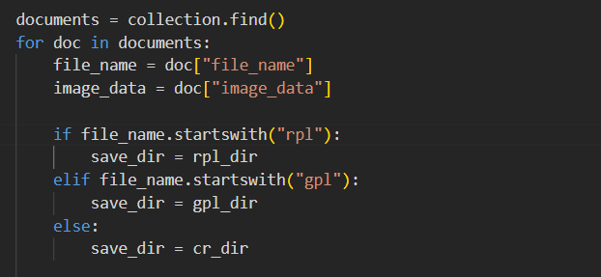
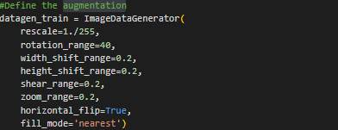
Data processing
Problem!
Dataset was not properly organize
Data Augmentation

Slide 9
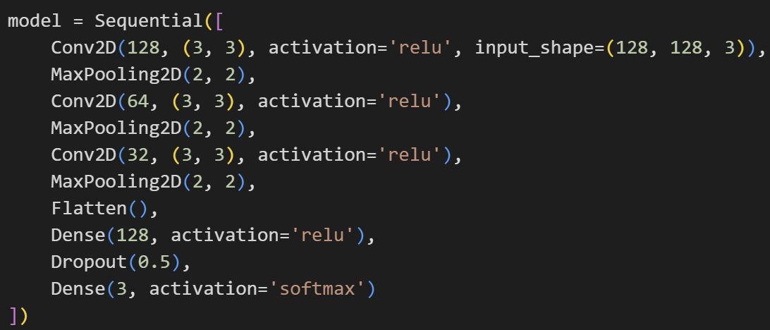
Build the CNN Model
Model Architecture:
Convolutional layer to learn and extract features.
Max pooling layer to reduce the dimension of the features.
Flatten layer to prepare it for the fully connected layers.

Slide 10
Build the CNN Model
Model Architecture:
Dense layer with ReLU activation to learn complex patterns.
Dropout layer helps with regularization.
output layer with softmax activation give us the probabilities of the 3 classes.

Slide 11
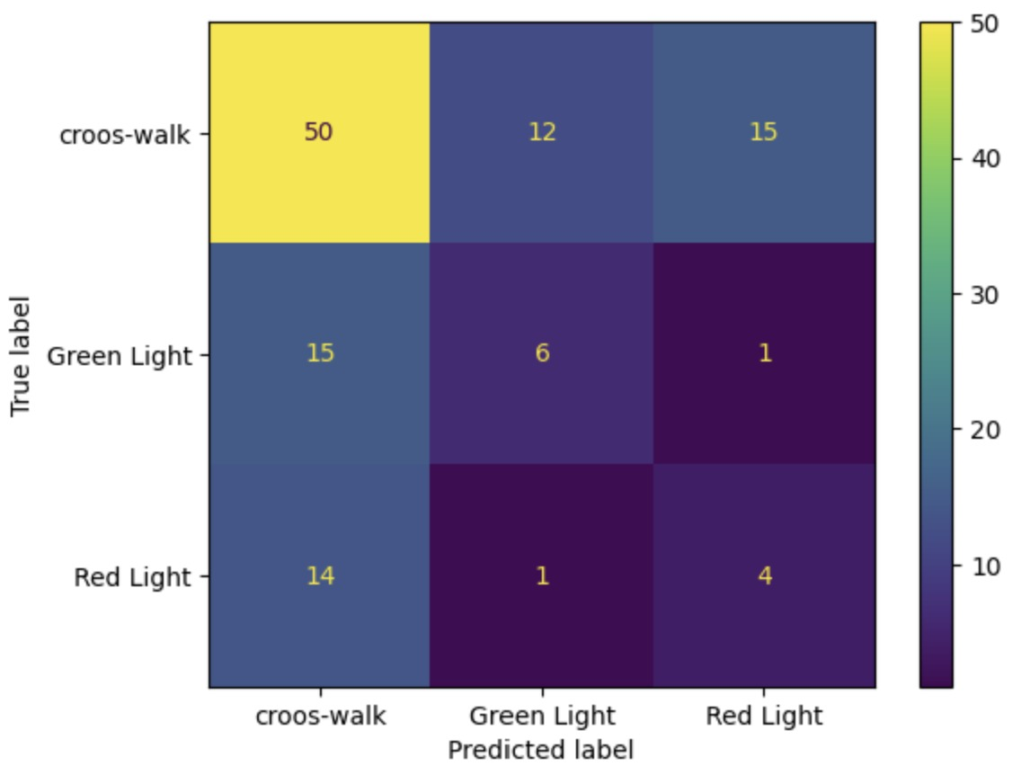
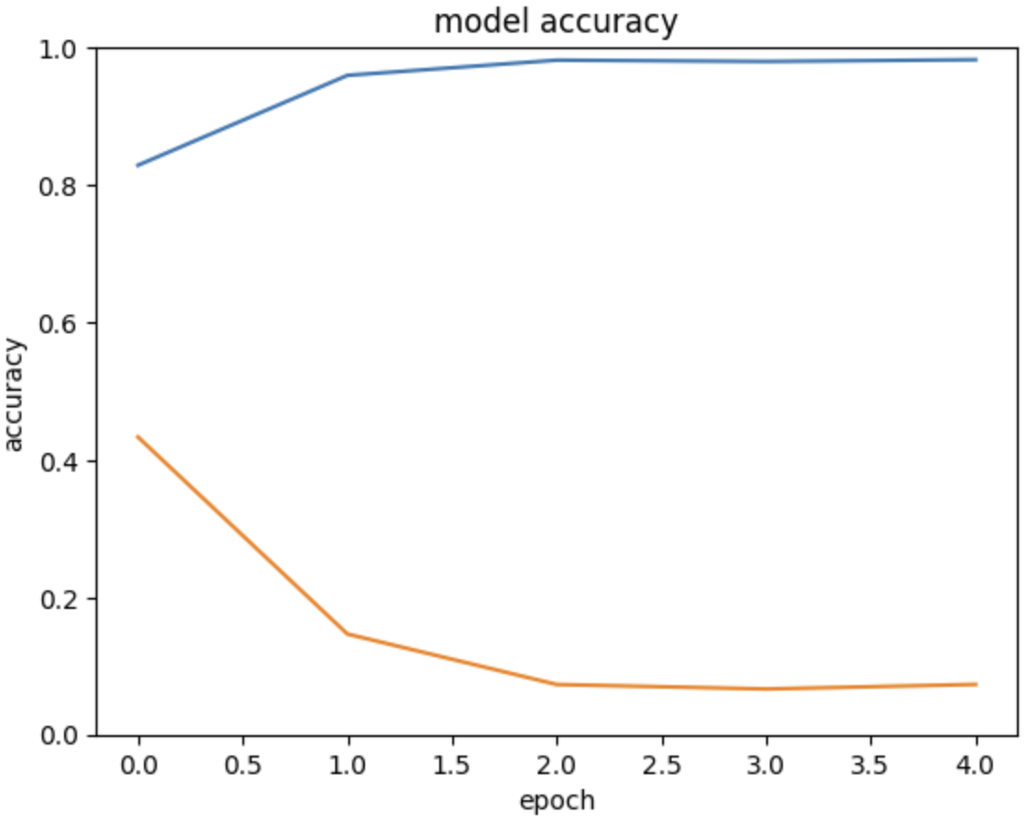
Evaluate the model

Slide 12
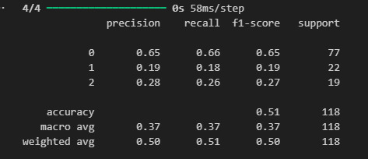
Visualize The Results
Try number | 1 | 2 | 3 | 4 | 5
Accuracy | 0.55 | 0.51 | 0.56 | 0.45 | 0.48
Average Accuracy Score 0.51

Slide 13

Questions

